Slide 1
Sales Analysis

Slide 2
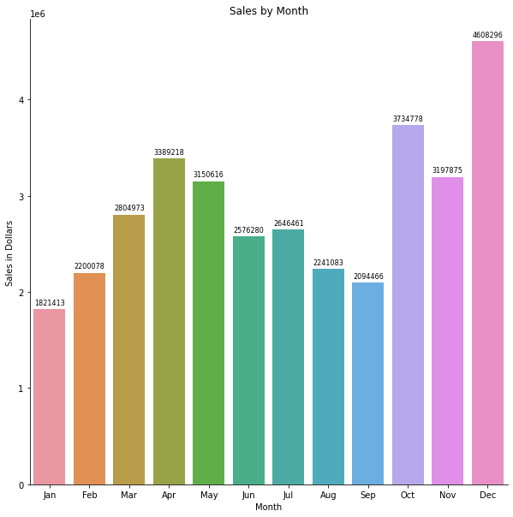
Sales by Month
What was the best month for sales? How much was earned that month?

Slide 3
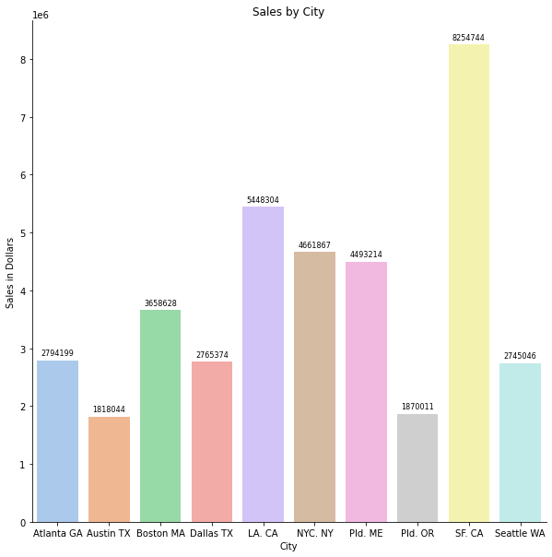
What city sold the most product?
San Francisco CA sold the most product.

Slide 4
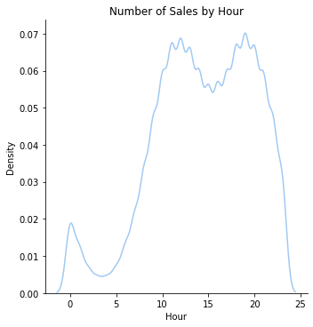
Ad time
What time should we display advertisements to maximize the likelihood of customer’s buying product?
There are two peak times, noon and 8:00 pm.

Slide 5
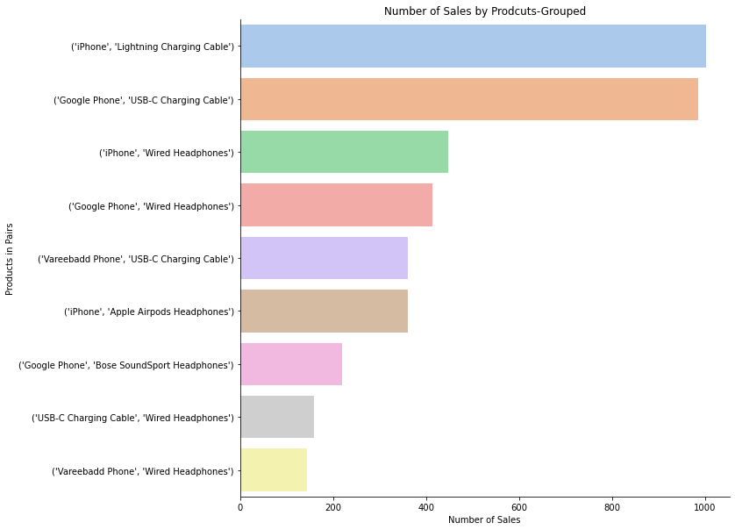
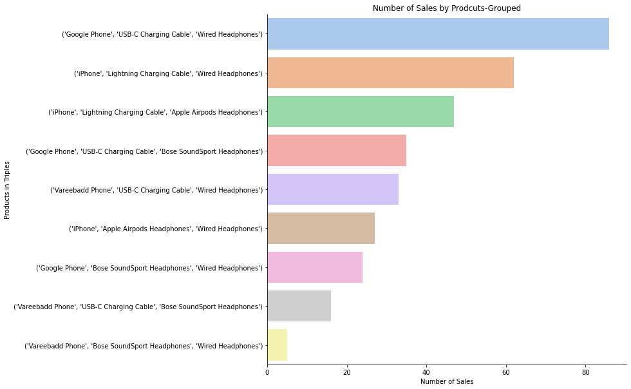
What products are most often sold together? These are grouped by pairs and triples.

Slide 6
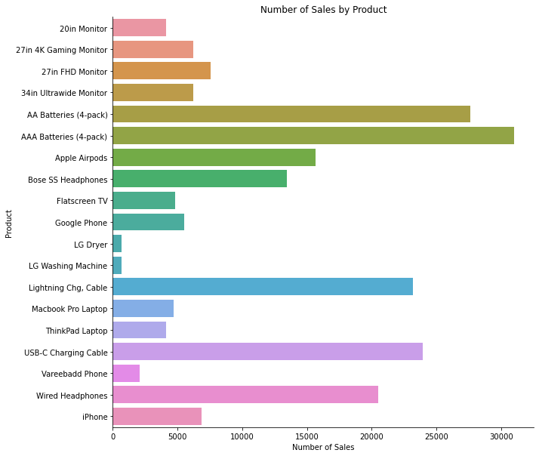
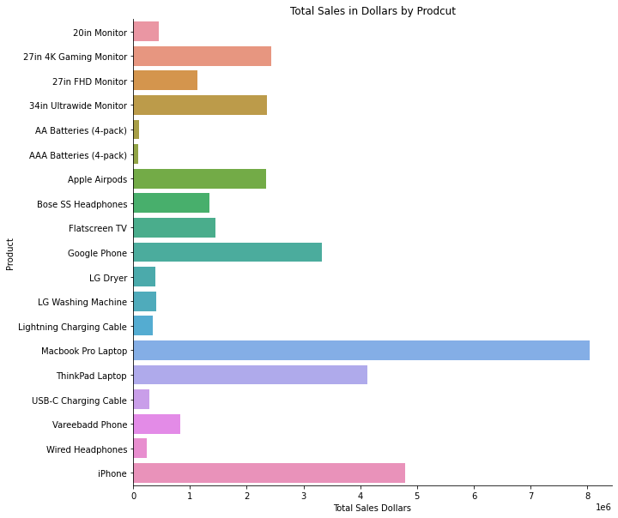
What product sold the most? Why do you think it sold the most? This was broken down into sales in dollars and sales volume. By volume, AAA batteries sold the most. By dollar amount, the MacBook Pro Laptop made the most money.

